Slide 1
Stacks
LIFO Data Storage

Slide 2
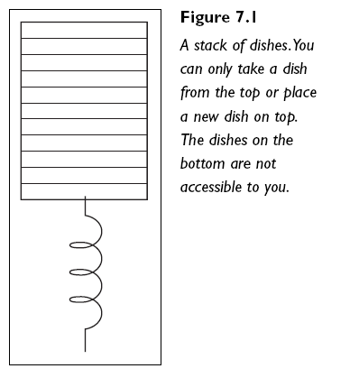
Introducing Stacks
If you have ever been to a buffet restaurant you will have seen stacks in action
When you approach a buffet you take the top plate from a stack of plates, then use it
When kitchen staff clean a plate, they put it on top of the stack of plates ready to be used by the next customer
This is exactly how a stack operates.

Slide 3
What makes a Stack?
A Stack is a specific type of sequence: a linear end-point sequence
Data is stored in linear sequence
Data can only be accessed at one end point, the top
This means data cannot be searched or amended within the sequence
A Stack works as LIFO - Last In, First Out
Last element to be added is the only thing you can currently access

Slide 4
Fundamental Operations for a Stack
Stack is a greatly reduced/restricted form of list
Stacks can only:
Add an element to top of the stack (push)
Remove the top element from the stack (pop)
Check the element on top of the stack without removing it (peek)
Count elements in stack
Check if the stack is empty

Slide 5
Stack ADT: A More Formal Definition
push(e) Insert element e at top of the stack
Input: Element to be added
Output: None
pop() Remove element from top of stack and return it. If stack is empty, an error should occur
Input: None
Output: Element
peek() Retrieve element from top of stack and return it. This should NOT remove the element from the stack. If the stack is empty, an error should occur
Input: None
Output: Element

Slide 6
Stack ADT Continued
size() Return the number of elements on the stack
Input: None
Output: Integer
isEmpty() Return a boolean indicating if the stack is empty
Input: None
Output: True/False

Slide 7
Where to Use a Stack
Tracking order of actions/processing in particular order
To achieve a specific goal/complete a specific task (as a programmer)
Common examples:
Tracking actions in a game (to allow for undoing)
Tracking pages visited in a browser (to allow for going back to previous page)
Tracking method calls in a program
Not used where you wish to:
Search
Add to the middle of the data
Sort the data stored
Notes:
* This is implementation-dependant, one version of List (link-based) is extremely good at this, while another (array-based) is extremely bad at it.

Slide 8
Implementing the Stack ADT
Arrays V.s. Linked Lists

Slide 9
Approaches to Stack Implementation
Just like Lists, there are two main approaches to coding an implementation of a Stack ADT
Array-based
Pointer/Link-based (LinkedList)
When implementing an array-based stack, track the index of the top of the stack
I.e. what number slot did we insert into most recently?
Insert into slot[size], then increase size
Remove from slot[size-1], then decrease size
When implementing a link-based stack, track the first node in the list
Always add to and remove from the front of the list

Slide 10
Array-Based Implementation
Two approaches within array-based implementation
Basic arrays
Dynamic arrays
Basic arrays provide a bounded stack
Only a certain amount of information can be stored
Anything over this limit causes a stack overflow exception
Unlike lists, this is a commonly allowed restriction for stacks
Dynamic arrays provide an unbounded stack
Any quantity of information can be stored – array will grow to accommodate it

Slide 11
The Down Side of Arrays
Arrays require memory to be reserved in advance, even when we don’t have anything to store yet
Consider this equation:
Stack to hold 100 GameMoves
Each GameMove requires 4 bytes for its memory address
How much memory must be allocated as soon as the empty Stack is created?

Slide 12
Link-based Stacks
Instead of allocating large chunk of memory in advance, we only allocate enough for:
All the objects we have in the stack so far
One more object to cover the next element to come (our next pointer)
This is an over-simplication, as all objects are wrapped in Nodes
Link-based stacks can actually cost more in memory when the data being stored is very small to begin with – why?

